Slide 1

A Fresh Look At Bond Investments
In A Changing Economy
Fixed Income Investment Model for Goldman Sachs
by RBS Team
Karan Sayal, Jonathan Soler, Thomas Fisher, Sid Basu,
Deepak Tammineni, Michael Winans
Notes:
Karan Sayal

Slide 2
Agenda
Goldman Sachs Challenge
Market Overview
Investing In An Uncertain Economy
Reassurance in Market Volatility
Bond Overview
Product Delivery
A Fixed Income Portfolio Model To The Rescue
Scenario Testing for Portfolio Optimization and Risk Management with Uncertain Markets
3 Scenario Model in action
Historical ETF Investing Approach
Go to Market Strategy
Notes:
Karan Sayal

Slide 3
Goldman Sachs Challenge
Individual investors traditionally favor laddered municipal bond portfolios due to their tax-exempt nature. However, proposed tax reforms could impact the exemption status of municipal bonds, necessitating a reevaluation of fixed-income investment strategies. The challenge is to develop a tax-aware, multi-asset-class model that considers:
Potential changes in taxation of municipal bonds
Optimization of fixed-income allocation across various asset classes
Dynamic portfolio adjustments based on evolving market conditions, cost basis, and tax implications
Notes:
Karan Sayal

Slide 4




Investing In An Uncertain Economy
S&P 500 decline by 6% due to new tariff plan
Ripple effect
of federal layoffs on local economy
Mass deportation would result in loss of $100B+
TCJA would raise after-tax return on investment by 3%
Economic uncertainty makes investment decisions riskier since it is harder for companies to accurately predict their future earnings during uncertain times
Notes:
Jonathan Soler
145% tariff on Chinese imports is causing cargo shipments from China to plummet and prompting major retailer to warn of likely price hikes and shortage of supplies. S&P 500 has dropped by 6% since the beginning of the year when the new administration took over ushering in the new tariff policy

Slide 5
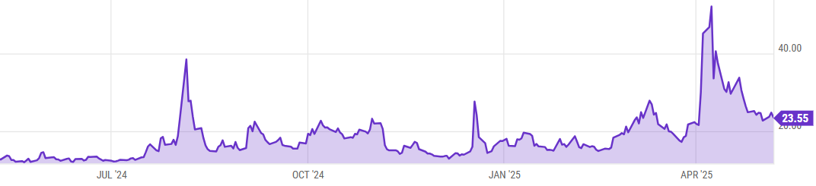
Reassurance in Market Volatility
Market volatility index rose as high as 52, first time since COVID
Increased fear and risk in the stock market
This enforces the importance of fixed income in a client’s overall Asset Allocation
Move money into fixed income for portfolio diversification, optimal yield, downside protection
Source: Ycharts VIX trend on 4.4.25
Notes:
Tom Fisher

Slide 6
Bonds: A Low Risk Investment Vehicle
Municipal Bonds
Debt securities issued by state and local governments
Interest paid is often tax-free, making it attractive for individuals in high tax brackets
Default risk is low
Can carry call provisions
Treasury Bonds
Risk-free US govt-issued debt securities
Generally taxable at the federal level, but not at the state level
Earn fixed semi-annual interest until maturity
At maturity, owner is paid a par amount equal to the principal
Corporate Bonds
Debt securities issued by a corporation
Taxable at federal and state levels
Higher risk than Treasury and Muni bonds
Can carry call provisions
Bonds are lower-risk and lower-return investments than stocks, which makes them an essential component of a balanced investment portfolio
Notes:
Tom Fisher

Slide 7
A Fixed Income Portfolio Model To The Rescue
Key Considerations:
Potential tax law changes under the new administration
Bond yields have changed a lot over the last 5 years
The FED began cutting rates in 2024 but is now on pause in 2025
Key Features:
Multiple scenarios based on investment preferences (high yield vs secure bonds vs stable income)
Optimized laddering strategy for risk adjusted returns
Yield curves and cash flow analysis
Allow this model to determine optimal fixed income allocation based on client tax scenarios and which bonds make sense based on resulting Tax Equivalent Yields
Notes:
Sid
5-Year Treasury Yield in last 5 years -
Apr 28 2020 - 0.37%
Apr 27 2021 - 0.88%
Apr 26 2022 - 2.79%
Apr 25 2023 - 4.95%
Apr 29 2024 - 4.65%
Apr 25 2025 - 3.98%

Slide 8
Scenario Testing for Portfolio Optimization and Risk Management with Uncertain Markets
Dynamically allocates wealth into different kinds of bonds based on investor’s input
Evaluates investor’s tax situation and manually invests in bonds where the returns are tax optimized
Creates a fixed income stream through coupons while wealth remains invested
Simulates multiple scenarios of pre-tax vs after-tax income generation
Shows how yield to maturity of an investment changes with time
Measures average portfolio ratings and duration to estimate credit and interest-rate risk exposure of the investment
Notes:
Sid

Slide 9
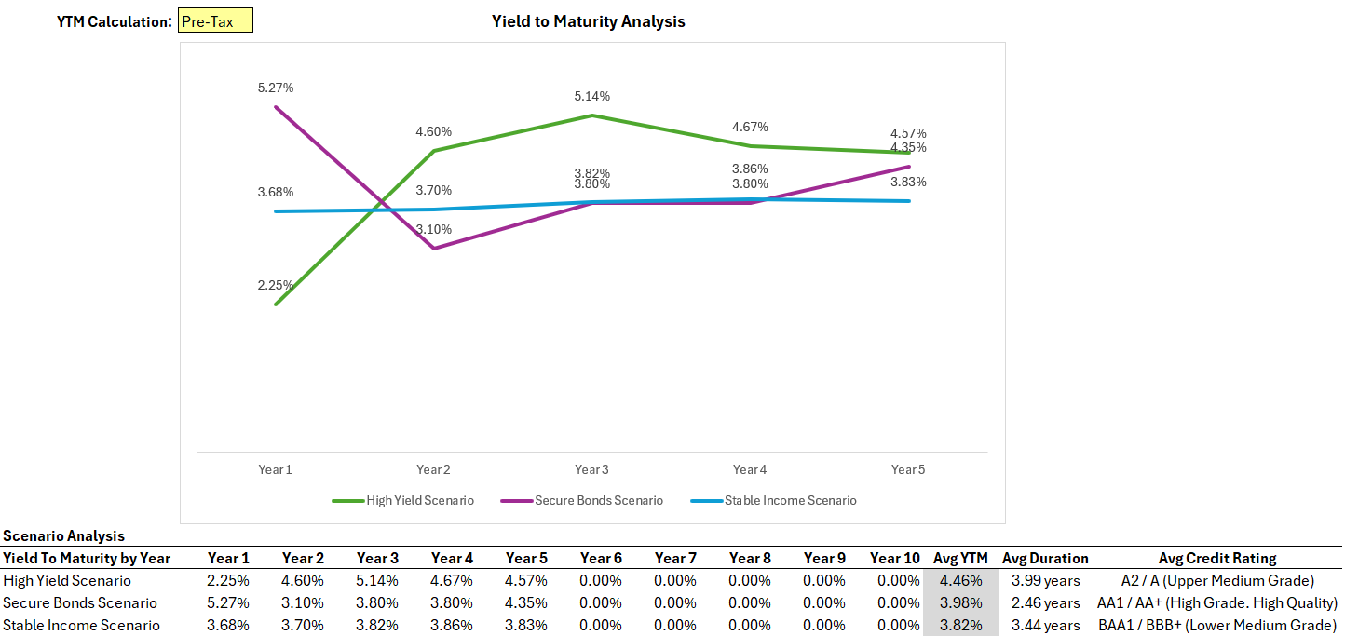
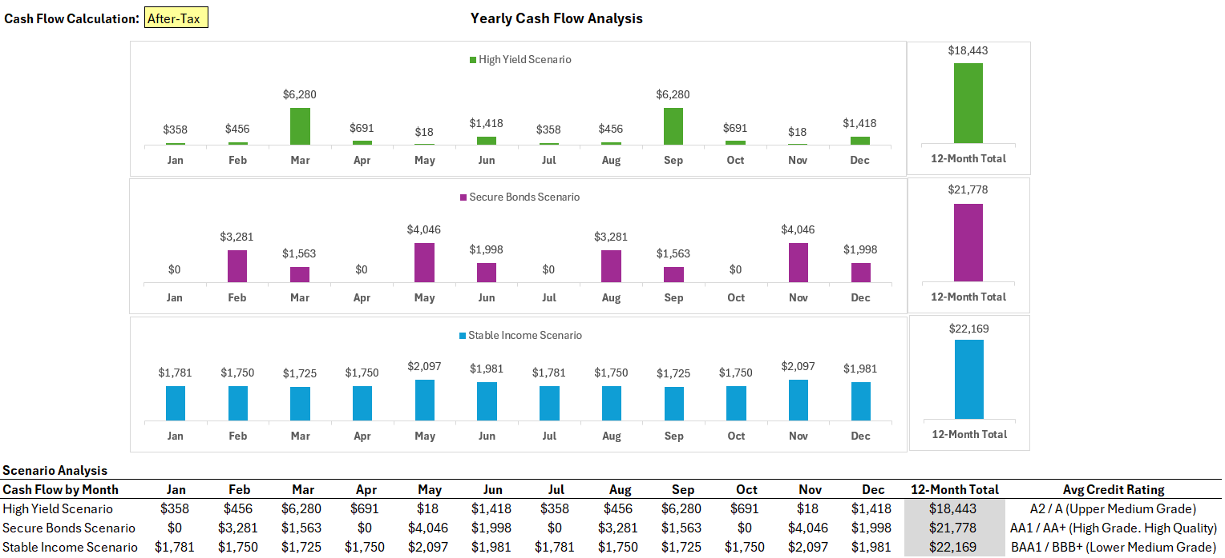
3 scenario model in action
A base model which takes user inputs to come up with bonds where investment can be made
Multiple scenarios of returns based on manually selected bonds and their weightages
Notes:
Deepak

Slide 10
Alternative Approach to Investing in Bonds
Investing in Bonds through ETFs
Portfolio optimization can be performed through risk-reward analysis using the efficient frontier model
Laddering approach of investment already handled by fund manager
Why?
Easier to invest
Risk reduced as investment can be made into multiple bonds with a purchase of an ETF
Low Expense Ratio
More Liquid - Can be traded on Exchange through broker account
How Does it work?
Investment can be made using ETFs that manage a bucket of bonds
Coupons are paid as dividends at the beginning of the month
Can be added as a stock to the SMA
How is Risk Managed?
Risk on investment can be determined through Efficient Frontier graph
Unsystematic risk is already managed by fund manager of the ETF

Slide 11
Go-To-Market: A Scalable SMA Tool
Strategic Phases
Introduce laddered bond portfolio scenarios as an SMA tool based on investor profile.
Diversify “Core+” asset-classes beyond “Core”.
Leverage in-house teams to integrate financial model
Technology Upgrade
Programing language - Python
Real time asset-class pricing data - MarketAccess, Bloomberg, S&P, etc.
Workload automation tools - AutoSys & Jenkins
Project Management - JIRA

Slide 12
Expansion and Long-Term Success
Product Offering Diversification
Core
US Treasury Bonds
Corporate Bonds
Municipal Bonds
Core+
Zero-Coupon Bonds
High-Yield Bonds
International Government Bonds
Green Bonds
Other Fixed Income Products
Performance Benchmarking
Bloomberg Municipal Index
Compare performance to Deepak’s Historical Model
Scale Investor Risk Tolerance Profile

Slide 13
Thank You

